Slide 1

Farm Finance Manager
Beef Farm Module

Slide 2
Introduction
This project was created for my fourth year project.
The goal of this project is to keep track of a farmers finances for the farm.

Slide 3
Research
For my research, I looked into finance managers for farms.
I continued to look into current finance managers for home budgets and businesses.
I have also looked into the common elements of what makes a finance manager.

Slide 4
Research
To do this I have looked into the top three finance managers from an internet review forum.
http://personal-finance-software-review.toptenreviews.com/
This is where I took the three top finance managers to compare.

Slide 5
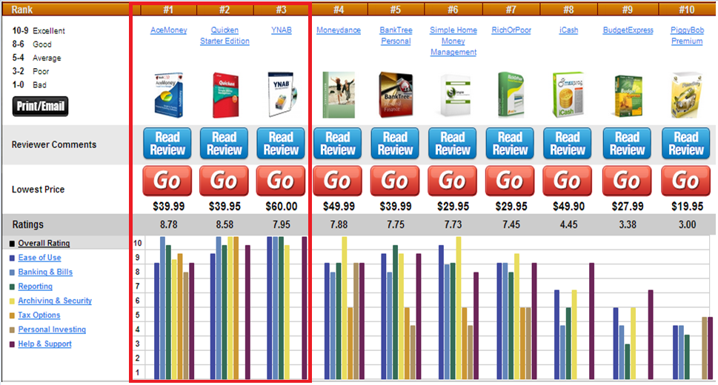
Research

Slide 6
Research
Researching these three products, I compared;
Prices.
Services provided.
Ease of use.

Slide 7
Common Elements
There was quiet a few common elements.
Spreadsheets.
Graphs.
Compatible Operating Systems.

Slide 8
Requirements
Funtional Requirements:
Some requirements for this project include;
Create a new herd.
Create a new animal.
Enter expenses for the farm.
Show information in a graph and text format.

Slide 9
Requirements
Non-Funtional Requirements:
Some requirements for this project include;
Be quick when returning information.
Not overload the user with irrelevant information.
Use colours to highlight information.

Slide 10
Design
Use multiple components.
Make it modular.
Will only include functions for beef farmers.
Other modules include:
Tillage.
Dairy.
Etc.

Slide 11
Conclusions
This project will be the first finance manager to specifically deal with farmers.
Will use common elements found in a finance manager, along with unique features to accommodate the specific needs of the farmers finances.

